Slide 1
MY DREAM
ArminC

Slide 2

1
1
My dream in my lifetime is just to
succeed with my career and to have
my own paid job, without depending
on anyone. As a dream job, I’d like
something around the Computers
& IT area. A simple example
would be to create a successful game.
But of course, I don’t know what the future holds for me.

Slide 3
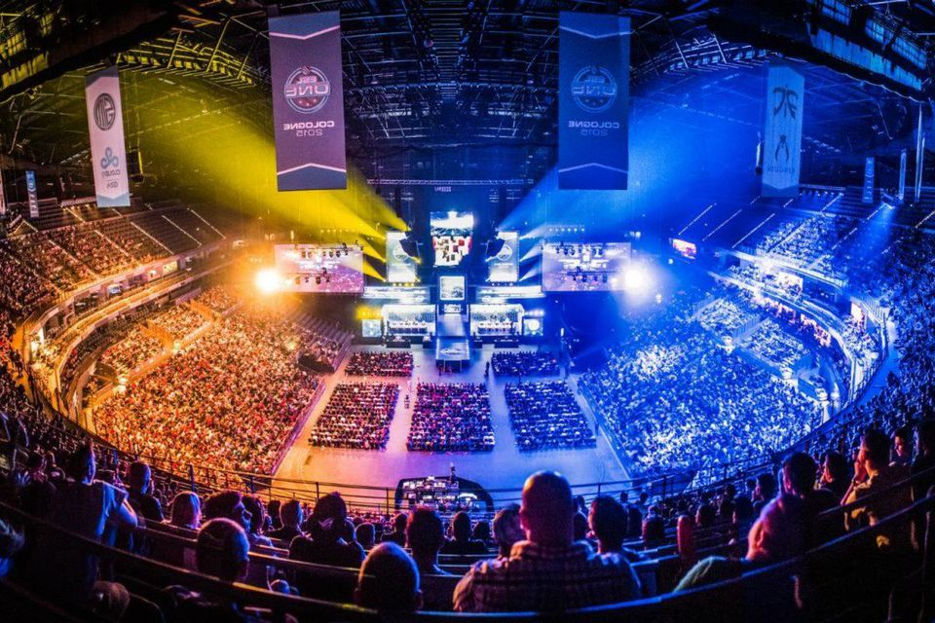
2
As an alternative, I would like very much to be an eSport player or to have a content channel on the YouTube platform, Twitch…
My favorite game is Counter-Strike and I would like to be on a team playing it, at least as a hobby.

Slide 4

3
For me, it’s enough to have a normal life, with a normal wage, unlike the others that dream to have an empire.
My only concern is to have time for my personal life and don’t waste it only working. I would like to make a lot of trips in nature and to visit new locations, especially in our beautiful country.

Slide 5
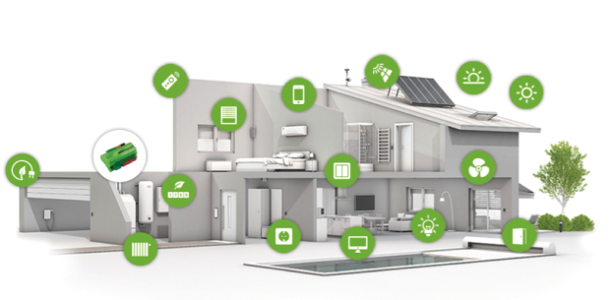
4
I spend my time, other than in other places, home. My dream home is a fully automated one, digitalized, with a home assistant and so on, like controlling the light bulb color, the intensity just by speaking or another example would be to control the window from my phone when I’m not home.

Slide 6

3
In order for me to have a dream life, I will try to have a healthy life, to be joy and active and I’ll try to avoid the stress of the everyday.
Another step to fulfill my dream life is to help others with their problems and ensure their own dreams.
As an end, I want to say that I don’t have big dreams, just some realistic nice ideas and
sometimes we can’t control
our future... I let it flow.

Slide 7

THE END!
“My dream” Presentation - ENGLISH

